Slide 1

Static website for a car dealership company

Slide 2
objectives
To build a static website that is used for car shows.
Demonstrates what’s the car and an image showing the cars on the website.

Slide 3
Methodologies
The website that I did, used only S3 service to make the web site and for the code I used Virtual studio.

Slide 4
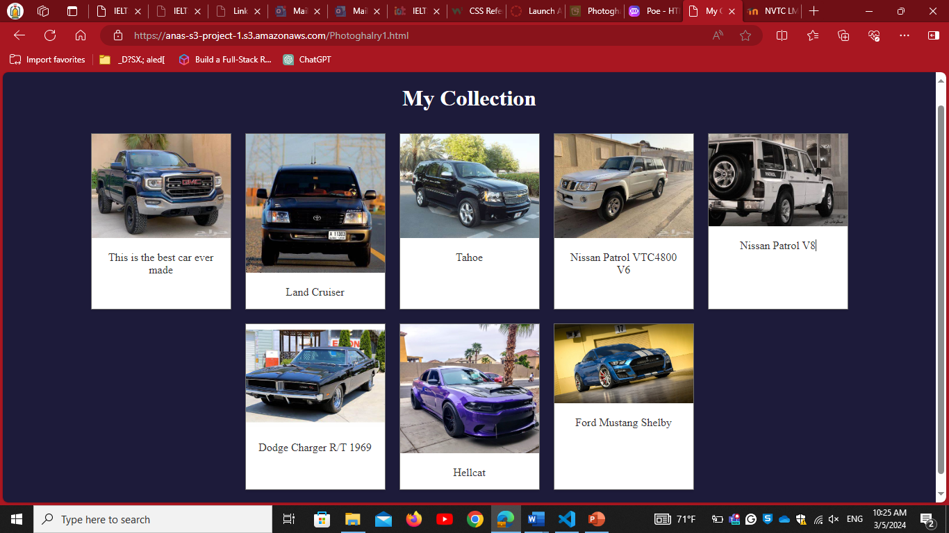
Results

Slide 5
functionalities
The website is used for knowing the car type and how does it look like

Slide 6

future improvements
My future improvements are making the website used for putting up cars for sale, showing prices for each car, putting more info about the cars and categories the cars by model and classification
And on the website improvements use CloudFront service to make faster access to the website.

Slide 7
Thank you

